Slide 1
Chapter 3
Product and Service Design

Slide 2
Outline
Introduction
Process of products development
Factors to consider
Performance measures of products development
Notes:
2

Slide 3

New Product Design
Companies continuously bring new products to market
Product design is integral to success

Slide 4
Process of New Product Development
Phase 0: Planning
Phase 1: Concept development
Phase 2: System-level design
Phase 3: Design detail
Phase 4: Testing and refinement
Phase 5: Production ramp-up

Slide 5

Phase 0: Planning
Begins with corporate strategy
Includes
  Assessment of technology developments
  Market objectives
Output
  The project mission statement
  Project approval

Slide 6
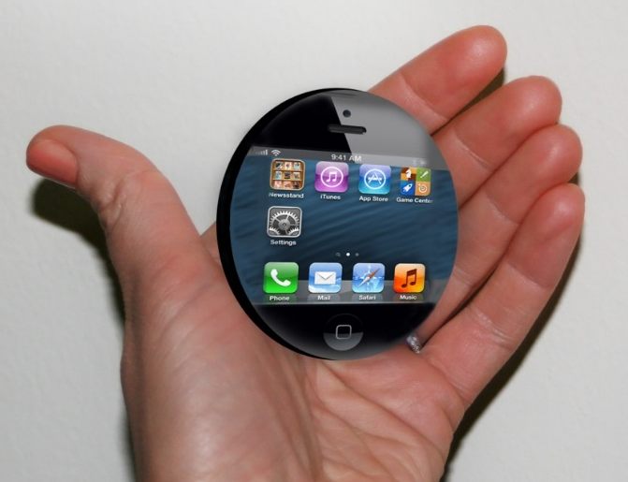


Phase 1: Concept Development
  Concept: A description of the form, function, and features of a product
  Identify the needs of target market
  Generate alternative concepts
  Evaluate and select one or more concepts

Slide 7
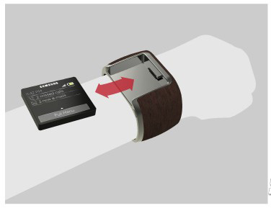
Phase 2: System-Level Design
Product architecture
Decomposition into subsystems
Assembly scheme
Output:
  Geometric layout of the product
  Functional specifications for each subsystem
  Preliminary process flow diagram

Slide 8
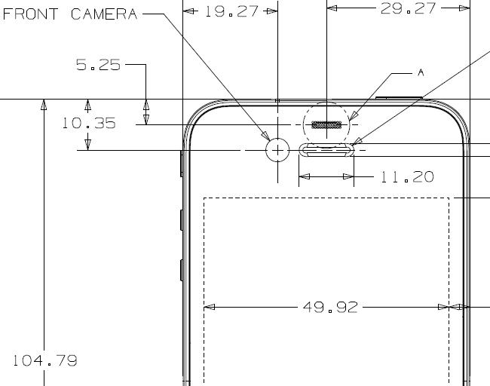
Phase 3: Design Detail
Specification of the geometry, materials, and tolerances for all parts
Some parts and tools to be purchased
Output:
  Drawings describing the geometry of each part and its tooling
  Specifications of purchased parts

Slide 9

Phase 4: Testing and Refinement
Evaluation of multiple preproduction versions of product
Prototypes tested to determine if the product will work as designed

Slide 10
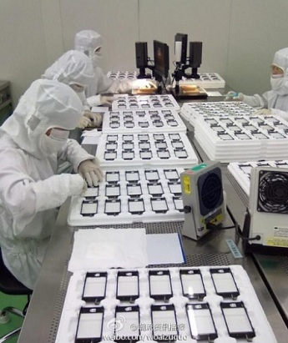
Phase 5: Production Ramp-Up
Intended production system is used
Train workers
Resolve any remaining problems
Transition to ongoing production

Slide 11
Outline
Introduction
Process of products development
Factors to consider
Performance measures of products development
Notes:
2

Slide 12
Factors to Consider
Design for
Customer
Ideal Products
Design for
Manufacturing
  Design for
  Environment

Slide 13

Design for Customers
Quality Function Deployment
  An approach to guide the design, creation, and marketing of goods and services by integrating the voice of the customer into all decisions.
  Inter-functional teams from marketing, design engineering, and manufacturing

Slide 14
Quality Function Deployment
  Customer wants and needs → Technical requirements of a product or service.
House of quality
  Begins with listening to the customer
  Translate customer requirements into operating or engineering goals
Notes:
6

Slide 15
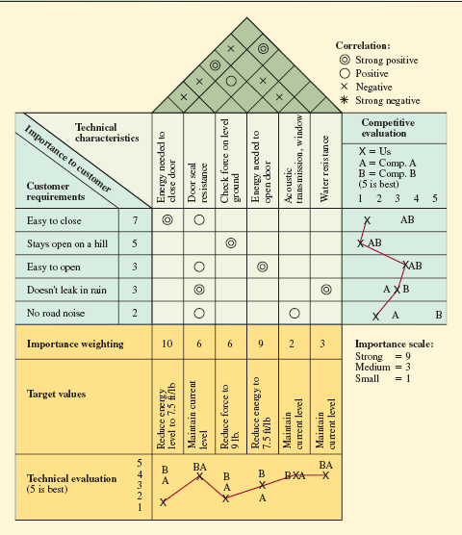
House of Quality for a Car Door (Page 52)

Slide 16
Factors to Consider
Design for
Customers
Ideal Product
Design for
Manufacturing
  Design for
  Environment

Slide 17
Design for Manufacturing
Traditional approach
  “We design it, you build it”
Concurrent engineering
  “Let’s work together simultaneously”
Notes:
9

Slide 18
Design for Manufacturing (Cont.)
Simplify products and processes
Achieve better performance at a lower cost
  Not necessary features?
  Parts be combined?
  Cut down the weight?
  Nonstandard parts be substituted or eliminated?
Notes:
8

Slide 19
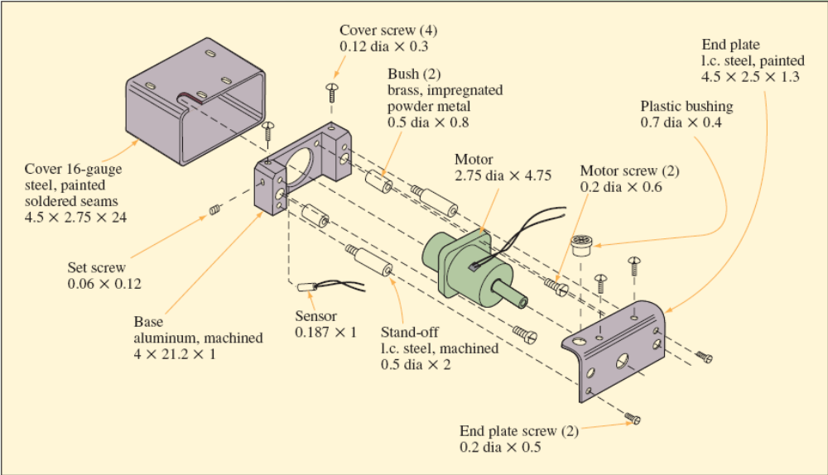
Proposed Motor Drive Design

Slide 20
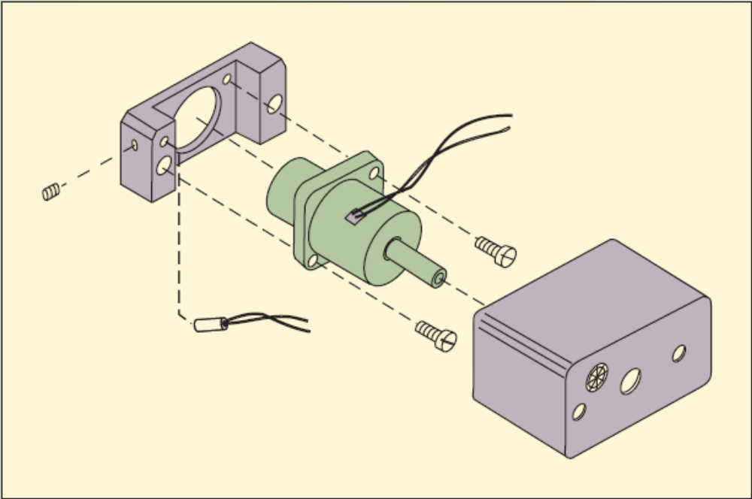
Redesign for Manufacturing and Assembly

Slide 21
Factors to Consider
Design for
Customers
Ideal Product
Design for
Manufacturing
  Design for
  Environment

Slide 22

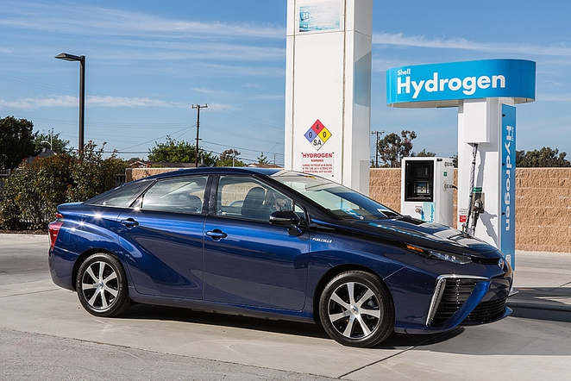
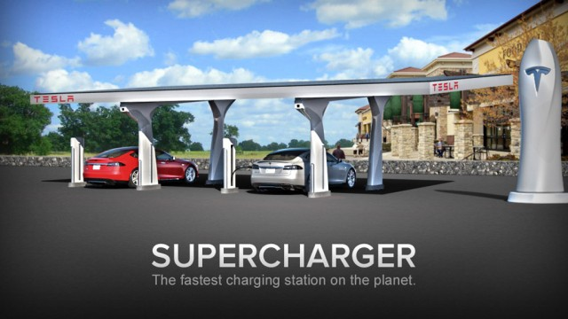
Ecodesign
Ecodesign: the incorporation of environmental considerations in the design and development of products or services
  The product is considered as a system
  The whole life cycle is considered
  Application of ecodesign can benefit business

Slide 23
Outline
Introduction
Process of products development
Factors to consider
Performance measures of products development
Notes:
2

Slide 24
Measurement
A steady stream of new products is important to competitiveness
  Respond to changing customer needs and competitor moves
  Ability to identify opportunities and bring new products to market is critical
Some performance dimensions
  Time to market/Productivity/Quality

Slide 25

Innovation
Creativity is seeing things in new or novel ways
Innovation is the process and outcome of creating something new, which is also of value.
Innovation = Creativity + Commercialization

Slide 26



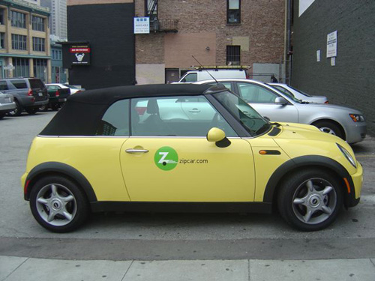
Four Types of Innovation
Francis and Bessant (2005)
Product innovation | Process Innovation
Position Innovation | Paradigm Innovation

Slide 27
Summary
Introduction
  Critical to success
Process of products development
  Six stages
  IKEA case
Factors to consider
  Customers
  Manufacturing
  Environment
Performance measures of products development
  Steady stream
  Time to market/Productivity/Quality
Notes:
2

